Slide 1

CLASSES & OBJECTS

Slide 2
SESSION OVERVIEW:
DEFINING A CLASS
CREATING AN OBJECT
CONSTRUCTOR & DESTRUCTOR
CONSTRUCTOR OVERLOADING
ATTRIBUTES & IT’S TYPES
PRIVATE METHODS & VARIABLES
DATA HIDING & OBJECT PRINTING

Slide 3
OOP TERMINOLOGY
Class − A user-defined prototype for an object that defines a set of attributes that characterize any object of the class.
Attributes − data members (class variables and instance variables) and methods, accessed via dot notation.
Class variable − A variable that is shared by all instances of a class. Class variables are defined within a class but outside any of the class's methods. Class variables are not used as frequently as instance variables are.
Data member − A class variable or instance variable that holds data associated with a class and its objects.
Function overloading − The assignment of more than one behavior to a particular function. The operation performed varies by the types of objects or arguments involved.

Slide 4
Instance variable − A variable that is defined inside a method and belongs only to the current instance of a class.
Inheritance − The transfer of the characteristics of a class to other classes that are derived from it.
Instance − An individual object of a certain class. An object obj that belongs to a class Circle, for example, is an instance of the class Circle.
Instantiation − The creation of an instance of a class.
Method − A special kind of function that is defined in a class definition.
Object − A unique instance of a data structure that's defined by its class. An object comprises both data members (class variables and instance variables) and methods.
Operator overloading − The assignment of more than one function to a particular operator.

Slide 5
CLASSES & OBJECTS
PYTHON is a object oriented programming language (OOP’s)
Procedure oriented => functions
Object oriented => objects
OBJECTS: collection of data(variables) and methods(functions) that act on those data.
CLASS: a BLUE PRINT for the object

Slide 6

EXAMPLE
We can think of CLASS as a SKETCH(prototype) of a house.
It contains all the details about the floors, doors,windows,etc,..
Based on these descriptions we build the house, HOUSE is the OBJECT.
As many houses came be made from the description(blueprint),
we can create many objects from a class.

Slide 7

An Object is also called an Instance Of A Class
The process of Creating An Object is called INSTANTIATION.

Slide 8
DEFINING A CLASS
Like functions definitions begin with keyword “def”. In python , we define a class by using keyword “class”
SYNTAX:
class <class_name>:
<Attributes>
A class creates a new local namespace where all its attributes are defined.
Attributes may be data or functions.

Slide 9
SELF PARAMETER
The self parameter is a reference to the current instance of the class,
and is used to access variables that belongs to the class.
It does not have to be named self , you can call it whatever you like,
but it has to be the first parameter of any function in the class

Slide 10
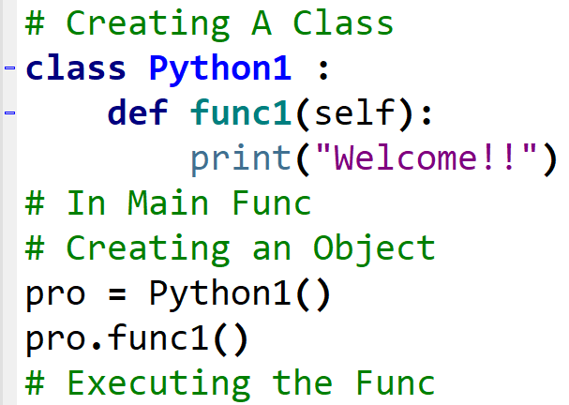
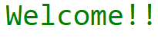
CREATION

Slide 11
NOTE
ACCESS SPECIFIER :
PRIVATE (_ _)
PROTECTED (_)
PUBLIC
In Python ,
By default , is Public not Private
Every Function without Arguments should have the Self parameter.
Attributes = Data or Functions present inside the class

Slide 12
CONSTRUCTOR !
A Special Kind of Function that Python calls Automatically When the Object is Created.
USES :
Initializing (assigning values) to Variables that the Object will Require when it Starts.
To Verify the Required Resources are Available
_ _init_ _() => Name of the Constructor , not the Class Name as in C++.
Python Automatically Creates a Default Constructor if it is not Defined.

Slide 13
DESTRUCTOR !
Destructors are called when an object gets destroyed
In Python, destructors are not needed as much needed in C++
because Python has a garbage collector that handles memory management automatically.
The __del__() method is a known as a destructor method in Python.
It is called when all references to the object have been deleted i.e when an object is garbage collected.
Using the Keyword del we can Delete the Attribute or even the Object Itself.

Slide 14
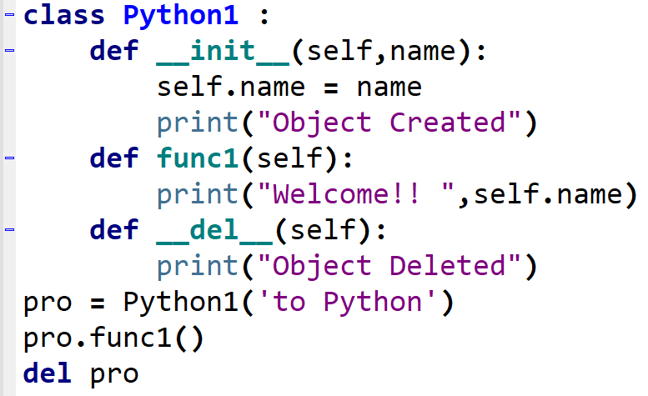
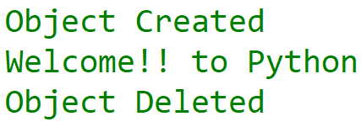

Slide 15
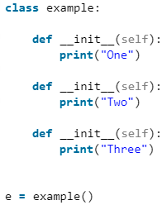
CONSTRUCTOR OVERLOADING
Python does not support explicit multiple constructors,
yet there are some ways using which the multiple constructors can be achieved.
If multiple __init__ methods are written for the same class,
then the latest one overwrites all the previous constructors.

Slide 16
To list the attributes of an instance/object, we have two functions:-
vars() : This function displays the attribute of an instance in the form of an dictionary.
dir() : This function displays more attributes than vars function, as it is not limited to instance.
It displays the class attributes as well.
It also displays the attributes of its ancestor classes.

Slide 17
PRIVATE METHODS & VARIABLES
In Python, there is no existence of “Private” instance variables that cannot be accessed except inside an object.
However, a convention is being followed by most Python code and coders i.e., a name prefixed with an underscore,
For e.g. _csc should be treated as a non-public part of the API or any Python code,
whether it is a function, a method, or a data member.

Slide 18
DATA HIDING
In Python, we use double underscore ( _ _) before the attributes name and
those attributes will not be directly visible outside.
PRINTING OBJECTS
Printing objects gives us information about objects we are working with.
In C++, we can do this by adding a friend ostream& operator << (ostream&, const Foobar&) method for the class.
In Java, we use toString() method.
In python this can be achieved by using __repr__ or __str__ methods.

Slide 19
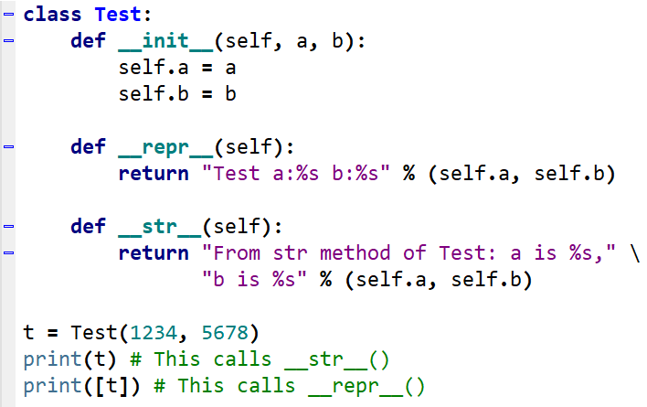


Slide 20

CODING IS FUN ! THANK YOU !!

